Slide 1

An overview of the grievance process in conjunction with Casanovas Recruitment Solutions
Rianna Billington Purvis & Karen Morovic

Slide 2
Agenda
Welcome and introductions
An overview of the grievance process
Case law review
Breakout group session
Feedback
1 February 2024

Slide 3
The grievance process
the grievance
investigation
grievance meeting
grievance outcome
initial grievance meeting
appeal meeting
appeal outcome
disciplinary process?
1 February 2024

Slide 4
What is a grievance?
Usually in writing, but doesn’t have to be
Does not need to be labelled a grievance
Complaints that individuals raise with their employers
concerns, problems or complaints that individuals raise with their employers
Can relate to anything within an individual's work
1 February 2024

Slide 5

Steps on receipt of a grievance
Identify relevant policies and procedures
Options to resolve – informal or formal?
Identify relevant individuals
Acknowledge the grievance
Invite to a first grievance meeting to discuss, clarify and outline next steps
Provide information about any internal and external support
Query if any additional support is needed
1 February 2024

Slide 6
Initial grievance meeting
Establish in more detail/confirm matters to be investigated
Should be held without “unreasonable delay”
Appropriate notice needs to be provided
Ask the individual what resolution they seek
1 February 2024

Slide 7
Grievance investigation
Purpose → to find out all you reasonably can about the issue(s)
May be, but not always required
If a reasonable investigation is not carried out, any decisions made thereafter may be unfair
Investigations are covered by the Acas Code of Practice on disciplinary and grievance procedures, which is the minimum an organisation must follow
1 February 2024

Slide 8

Grievance meeting
Purpose → to decide whether the grievance/s raised are well founded and, if so, to reach decision on any resolution.
During the grievance meeting:
the grievance should be summarised
the individual given an opportunity to:
  to ask questions
  present their version of events and produce any evidence in support
the information received and points discussed summarised
the individual given the chance to clarify anything
1 February 2024

Slide 9
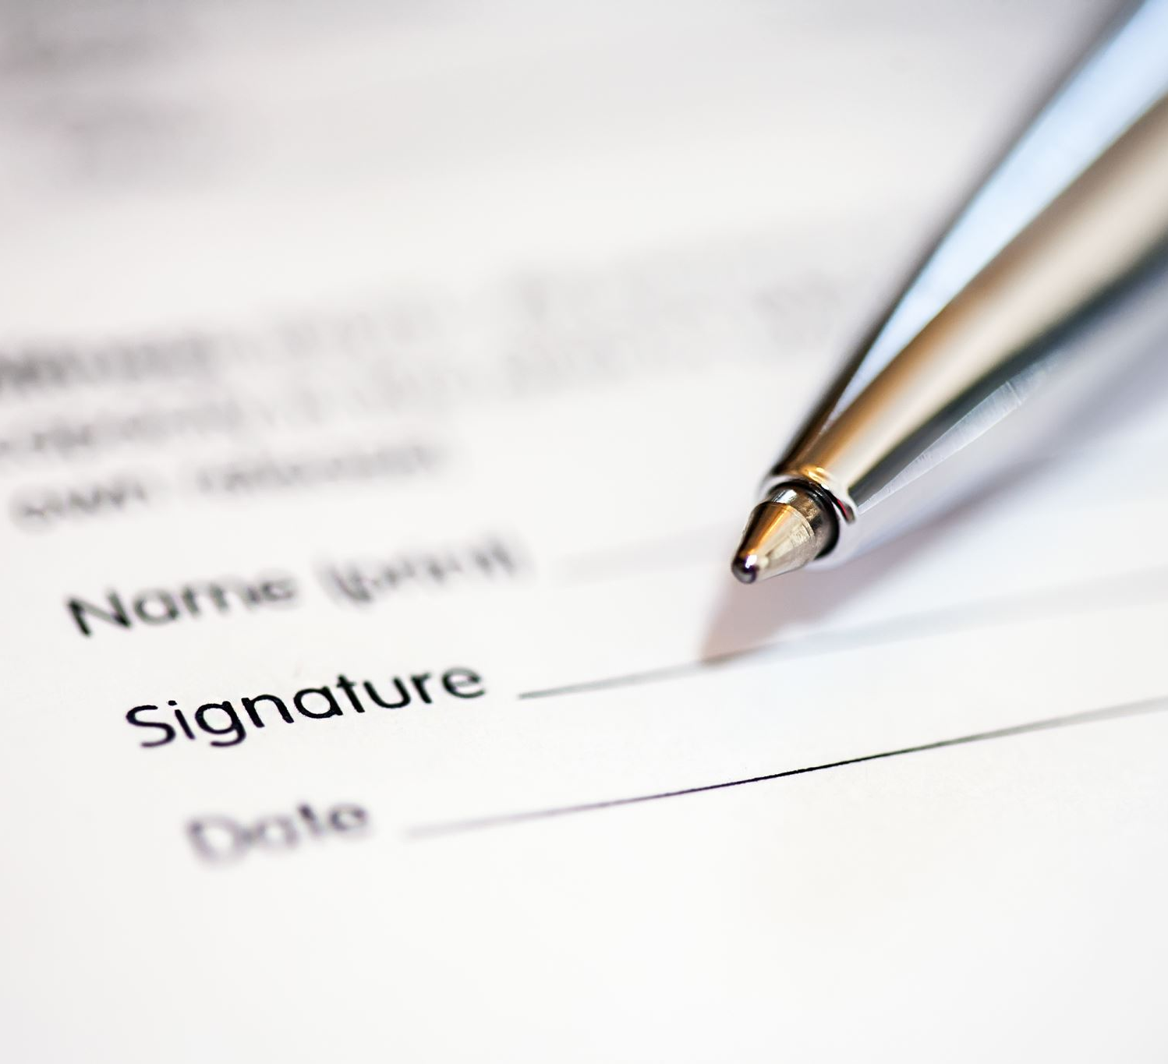
Grievance outcome
Should be adjourned for the decision to be considered
Will require two specific considerations:
  If grievance is upheld
  If so, what (if any) resolution
Possible resolutions include workplace mediation, relocation of one or more individuals, change in line manager or disciplinary action against an individual/s
If disciplinary action is recommended, a disciplinary process should then be followed
1 February 2024

Slide 10
Grievance appeals – a way to correct past mistakes?

Slide 11
Key points
Consider the appeal grounds carefully
Have mistakes been made?
Rehearing or reconsideration?
1 February 2024

Slide 12

Blackburn v Aldi Stores [2013]
David Blackburn worked at the Chelmsford depot as an LGV driver
David used to be a police officer, vehicle examiner and health and safety trainer
1 February 2024

Slide 13

Blackburn v Aldi Stores Ltd cont.
Incident with his manager led to grievance
Grievance procedure referred to in the handbook as contractual
Raised concerns re abusive treatment by line manager as well as health and safety and training concerns
Grievance hearing by MD for the region
Some parts upheld but not the abuse by the line manager
1 February 2024

Slide 14
Blackburn v Aldi Stores Ltd cont.
Employer’s failure to provide an impartial appeal may be a breach of the implied duty of trust and confidence
Implied term of trust and confidence:
An employer must not (Malik v BCCI, per Steyn LJ)
“[...] without reasonable and proper cause conduct itself in a manner calculated and likely to destroy or seriously damage the relationship of trust and confidence between employer and employee.”
1 February 2024

Slide 15
Blackburn v Aldi Stores Ltd cont.
EAT held:
Appeal should have been dealt with by a manager not previously involved in the case
Not all breaches of the grievance procedure will amount to a breach of the implied term of trust and confidence eg failure to meet a timetable
1 February 2024

Slide 16
“The right to an appeal in respect of a grievance is important both as a feature of the ACAS Code of Practice and Aldi’s own grievance procedure”
”..not easy to see why an organization the size of [Aldi] should have been unable to make provision for an impartial hearing by a manager not previously involved.”
Right to an appeal – key feature of employment law
1 February 2024

Slide 17

De Souza v Vinci Construction [2017]
Unreasonable failure to follow the ACAS Code
DELAY by previous employer!
Court of Appeal held that there had been unreasonable delay by the previous employer (before a TUPE transfer) in addressing the employee’s grievances and holding an appeal hearing
Underhill LJ emphasized that the Code requires that each step in handling grievances must be undertaken without unreasonable delay
1 February 2024

Slide 18
Grievances post termination
Harkins v Department for Work and Pensions [2013]
ACAS Code held to NOT apply where grievance raised after employment has ended
No uplift for unreasonable failure to follow
However – caution – refusal to handle the grievance will inevitably carry the risk re allegations of discrimination or harassment – refusal could be subject of a victimization complaint
1 February 2024

Slide 19
Breakout groups
Grievance invite letter
Grievance hearing
Grievance appeal invite letter

Slide 20
Questions?

Slide 21
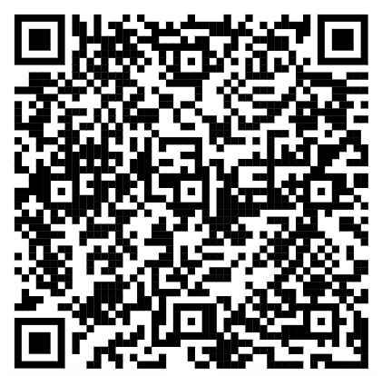
Let us know what you think! Please follow the QR code to complete a short survey:

Slide 22

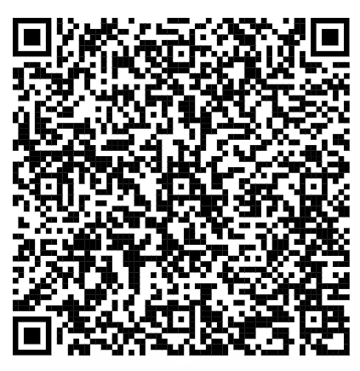

Birkett Long is going green! Please help support our NetZero initiative and use the following link to access the notes/slides from today:

Slide 23

BLHR
Need a one stop shop HR and employment law solution? Or do you just want to pick and mix from our services what you need…when you need it?
Let’s talk!
Visit the link below to find out what the BLHR Employment team can do for you.
www.birkettlong.co.uk/chatterbox
1 February 2024

Slide 24
Thank you!

