Slide 1

An overview of the disciplinary process in conjunction with Casanovas Recruitment Solutions
Julie Temple and Karen Morovic

Slide 2
Agenda
Welcome and introductions
An overview of the disciplinary process
Case law review
Breakout group session
Feedback from groups
Questions
24 April 2024
16 May 2024
27 June 2024

Slide 3
What is a disciplinary?
Breach company rules
Misconduct
Poor performance
Capability?
procedure to address conduct or performance
24 April 2024
16 May 2024
27 June 2024

Slide 4
Event/s
Suspension?
Investigation
Disciplinary hearing
Disciplinary outcome
Appeal
Appeal outcome
Grievance?
Appeal hearing
The disciplinary process
24 April 2024
16 May 2024
27 June 2024

Slide 5

Initial considerations on a disciplinary process
Check requirements of relevant policies
Options to resolve – informal or formal?
Choosing an appropriate investigator
Is suspension appropriate?
‘without unreasonable delay’
Interplay between policies and procedures
Availability of support
24 April 2024
16 May 2024
27 June 2024

Slide 6
Suspension?
Not knee jerk
Appropriate in serious misconduct or incompetence
Continued presence make an investigation difficult
Working relations broken down
On full pay
Confirm in writing
24 April 2024
16 May 2024
27 June 2024

Slide 7
Disciplinary investigation
Purpose → Establish the facts
Must be reasonable
Covered by the Acas Code of Practice on disciplinary and grievance
Always be required to some degree
24 April 2024
16 May 2024
27 June 2024

Slide 8

Disciplinary hearing
Purpose → decide whether the disciplinary allegations are well founded and, if so, decide sanction
During the disciplinary meeting:
Summarise the allegations
Give individual an opportunity to:
  ask questions
  present their version and produce evidence
Summarise the discussions
Give the individual the chance to clarify
24 April 2024
16 May 2024
27 June 2024

Slide 9
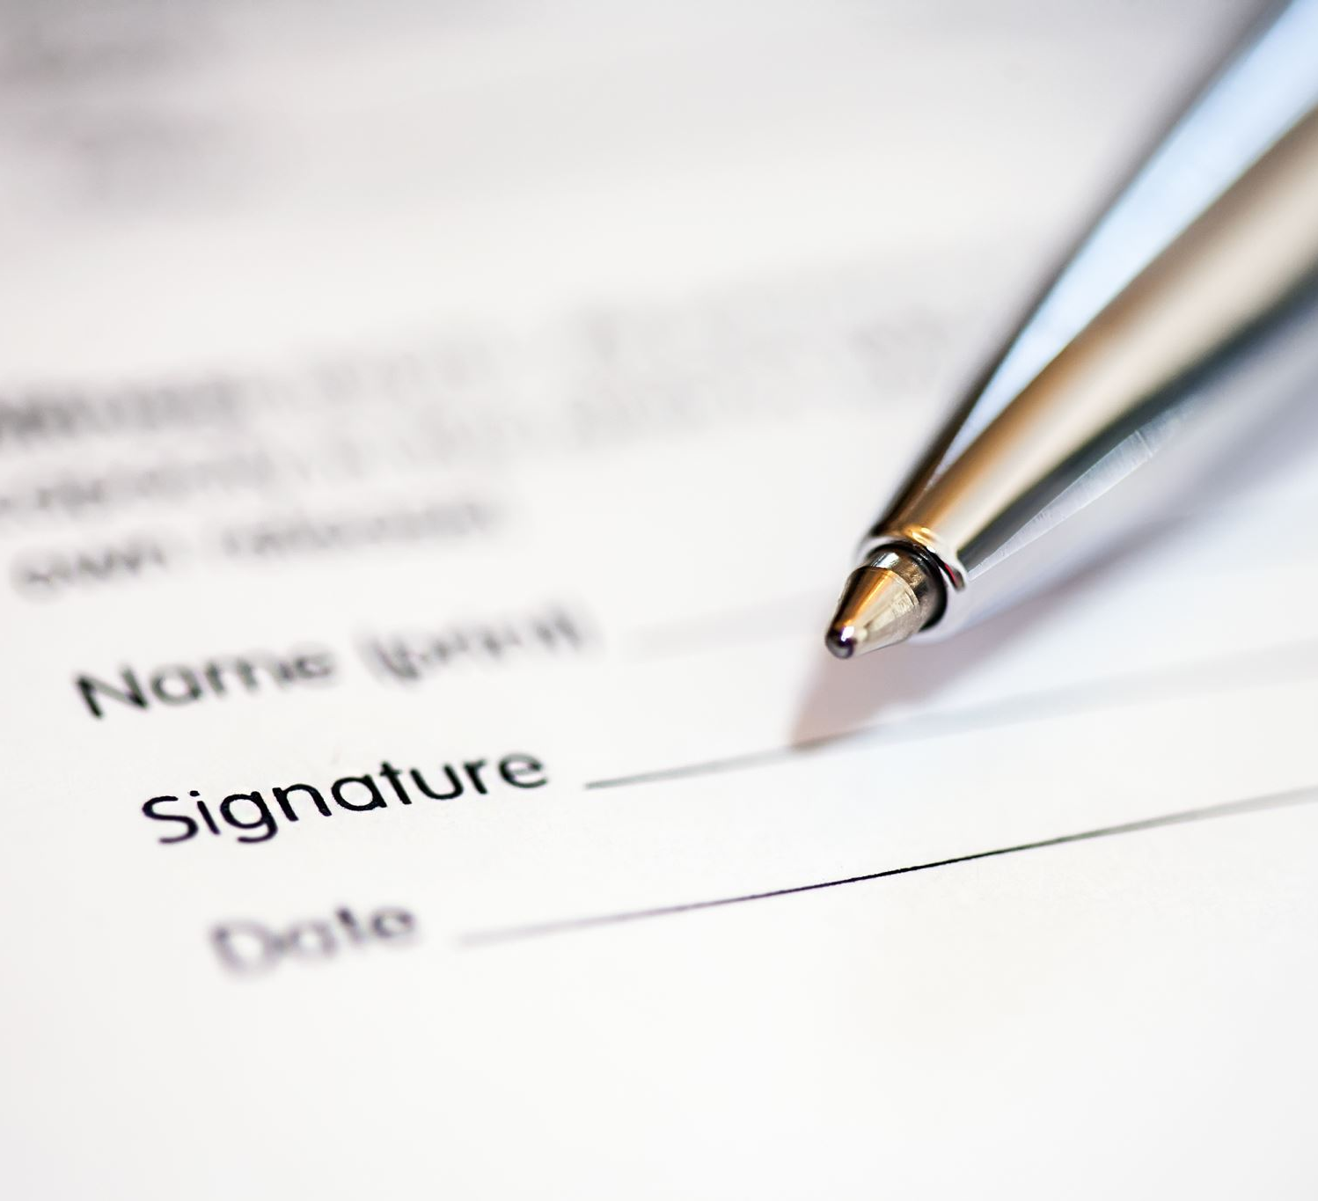
Disciplinary outcome
Adjourn
Two considerations:
  Are the disciplinary allegations founded
  If so, what should be the sanction (if any)
Decision communicated/confirmed in writing
Inform right to appeal
24 April 2024
16 May 2024
27 June 2024

Slide 10
Disciplinary appeals – a way to correct past mistakes?

Slide 11
Key points
Consider appeal grounds carefully
Have mistakes been made?
Rehearing or reconsideration?
24 April 2024
16 May 2024
27 June 2024

Slide 12
Khan v Stripestar Ltd [2016]
Making use of an appeal to correct failings in the disciplinary process:
The employee was dismissed following a disciplinary hearing that lasted around six minutes
The appeal manager suspended the hearing to investigate
The investigation was full and thorough
The dismissal stood
The employee unsuccessfully claimed unfair dismissal
A disciplinary process can be where the appeal process is thorough and reasonably conducted and there is sufficient evidence of gross misconduct
24 April 2024
16 May 2024
27 June 2024

Slide 13
Marangakis v Iceland Foods Limited [2022]
Summary dismissal
Appeal and initially requests reinstatement
Later requested apology and compensation
Appeal upheld and reinstatement with a final written warning
Employee not return to work and dismissed
Claim based on original dismissal
Successful appeal meant the dismissal vanished
24 April 2024
16 May 2024
27 June 2024

Slide 14
Collins v ILC Manchester Ltd t/a International Learning College [2012]
Always remember the statutory right to be accompanied:
The employee had been employed for two months
Called to a meeting
The employee requested a companion and asked for adjournment
This was refused and he was dismissed
The employee was awarded one week’s pay
24 April 2024
16 May 2024
27 June 2024

Slide 15

BLHR
Need a one stop shop HR and employment law solution? Or do you just want to pick and mix from our services what you need…when you need it?
Let’s talk!
Visit the link below to find out what the BLHR Employment team can do for you.
www.birkettlong.co.uk/chatterbox
DATE

Slide 16
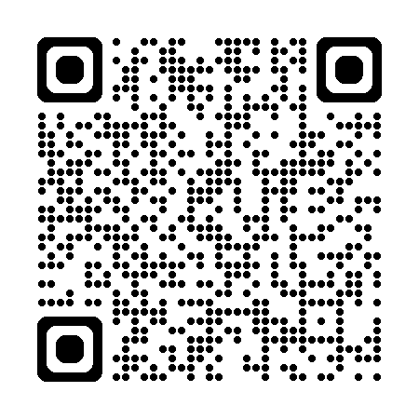
Let us know what you think! Please follow the QR code to complete a short survey:

Slide 17
Breakout groups
Disciplinary invite letter
Disciplinary hearing
Disciplinary appeal invite letter

Slide 18

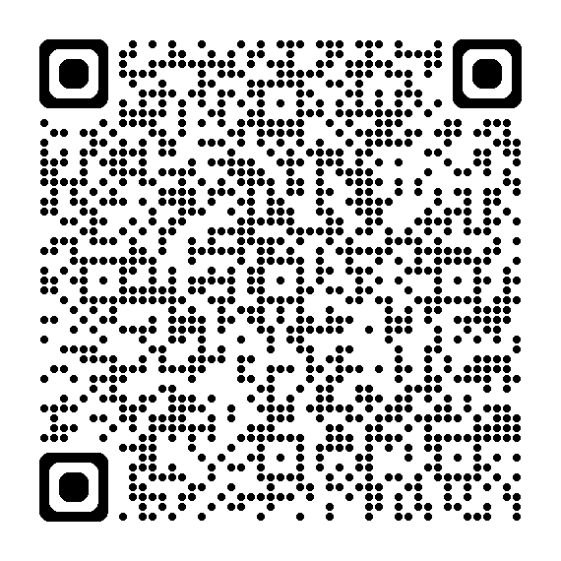

Birkett Long is going green! Please help support our NetZero initiative and use the following link to access the notes/slides from today:

Slide 19
Questions?

Slide 20
Thank you!

